Slide 1
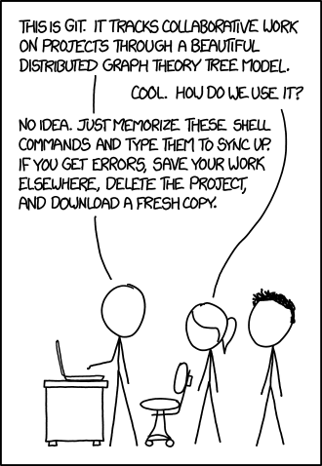
Understanding
GitHub

Slide 2
Class outline
What is GitHub?
Version control
Using GitHub
Python dependencies
Virtual environments
Markdown

Slide 3
What is GitHub
“web-based interface that uses Git, the open source version control software that lets multiple people make separate changes to web pages at the same time”

Slide 4
Open source = free
multiple people make separate changes = collaborative
So, Github is a free tool that allows users to work together on a project and tracks the local changes each one makes

Slide 5
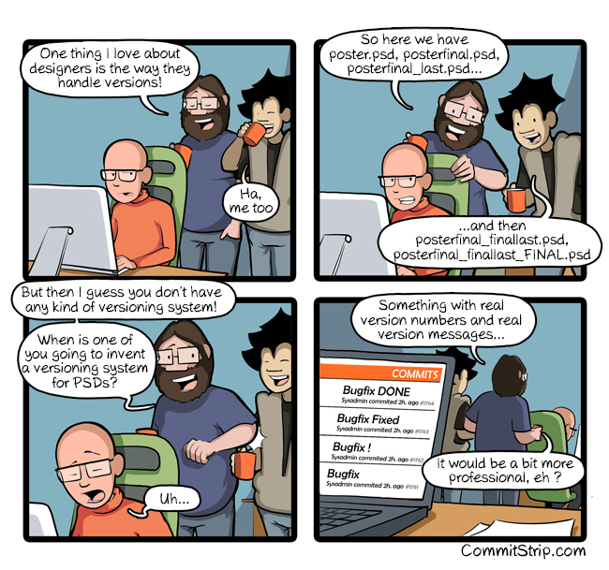
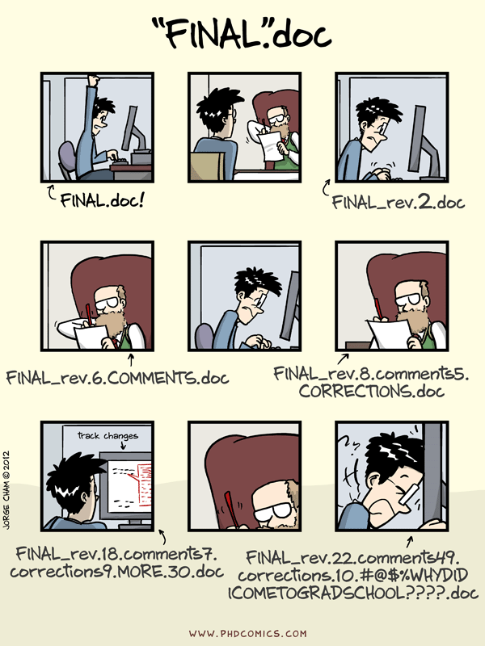
Version Control

Slide 6
What is version control?
practice of controlling, organizing, and tracking different versions in history of computer files
Change the code/text with ability to go back to earlier revisions
GitHub does this for you
Notes:
Mention dropbox and google drive as examples of version control

Slide 7
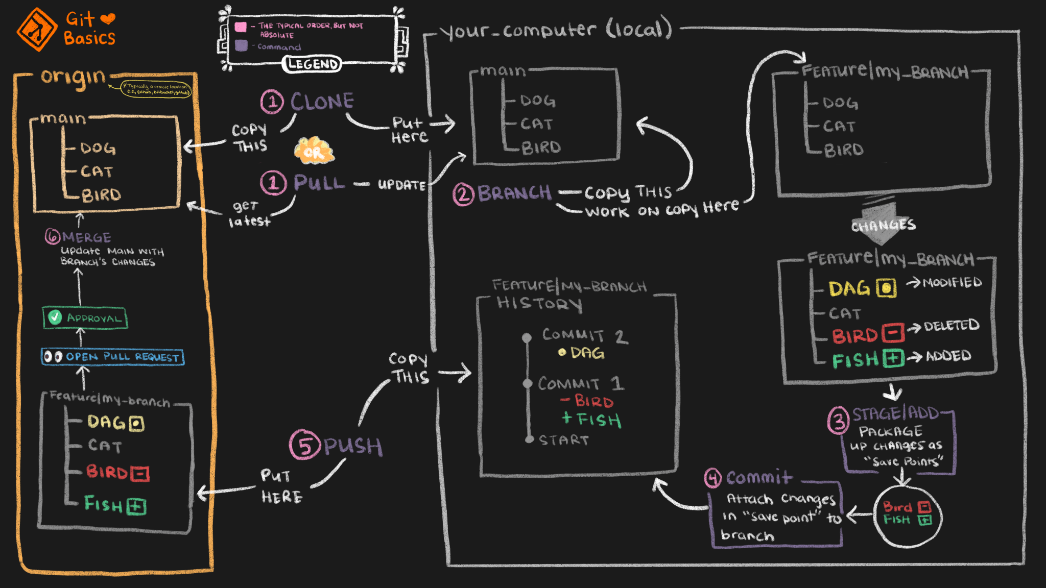
GitHub Workflow

Slide 8
Useful commands/files
git status – See what files on the local branch have been changed from the last commit
.gitignore – List of files or folders that will be ignored when moving between local and origin repositories
git log – Display all commits
git revert [commitid]

Slide 9
GitHub structure
Working directory
LOCAL FILES
Local repository
LOCAL CHANGES
Remote repository
STABLE VERSION

Slide 10
Working directory
Where all your local files are stored
Working directory
- File 1
- File 2
- File 3

Slide 11
Local repository
Where git keeps track of changes you want to make to repository
Information stored in .git folder
Local repository
Staging area
Commits

Slide 12
Remote repository
Cloud version of repositories
Master/main version and all branches
Remote repository
Master
Branches
- branch1
- branch2
- branch3

Slide 13
Key commands
Take files from GitHub repository
Prepare files for repository
Send files to repository
git clone
git pull
git add
git commit
git push

Slide 14
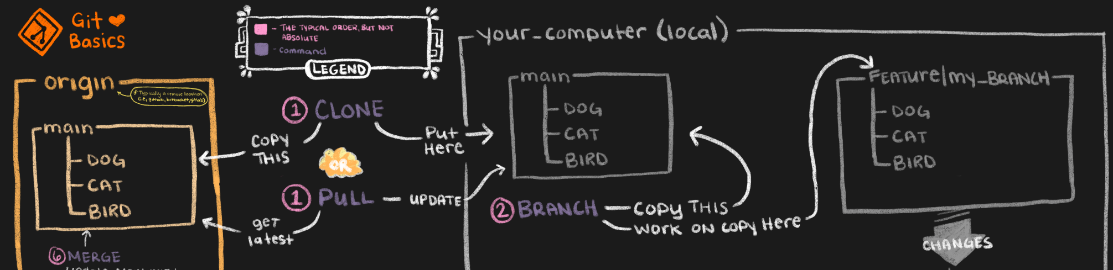
Taking files from GitHub
git clone – copy entire repository to a local directory
git fork – copy remote repository to local repository
git pull – copies files from new commits to local drive
git fetch – takes new files from remote repository to local repository

Slide 15
Git clone vs. git fork
git clone: Takes all files from remote repository and saves them to local directory
Remote repository
Readme.MD
Helloworld.py
requirements.txt
data/
Working directory
Readme.MD
Helloworld.py
requirements.txt
data/
git clone remote

Slide 16
Git clone vs. git fork
git fork: Move from remote repository to local repository
Remote repository
Readme.MD
Helloworld.py
requirements.txt
data/
Local repository
Readme.MD
Helloworld.py
requirements.txt
data/
git fork remote local

Slide 17
Git clone vs. git fork
git fork – Use when do not have write-access to remote repository
Still have to clone repository to move to working directory
To add to remote repository, submit pull request

Slide 18
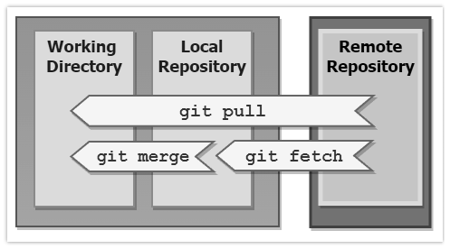
git pull vs. git fetch
What is the difference between git pull and git fetch?

Slide 19
Git pull
Copy all changed files from remote repository to working directory

Slide 20
Git fetch
Copy all changed files from remote repository to local repository
Use “git merge” to copy files in local repository to files in working directory
git merge: compare versions of the same files to see if changes are compatible

Slide 21
Creating a branch
Why create a branch?
  Work on features in isolation
  Make changes safely
git branch hello-world-images

Slide 22
Navigating branches
List branches: git branch -a
Move to a new branch: git checkout [ branch name]
Delete a branch: git branch –d [branch name]
Compare two branches: git diff [source branch] [target branch]

Slide 23
Adding files
Git does not automatically add changes to a file
  Files are saved in working directory
  Need to tell Git what changes to add to local repository

Slide 24
Git add
Copy files from working directory to local repository
Working directory
data/
Readme.MD
Helloworld.py
requirements.txt
NEWFILE.py
Local repository
git add NEWFILE.py
Staging area
NEWFILE.py

Slide 25
Committing files
Local repository
Staging area
NEWFILE.py
git commit –m “added NEWFILE.py
Commits
NEWFILE.py

Slide 26
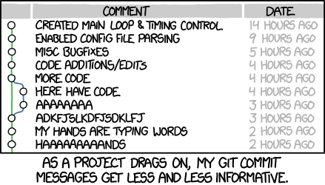
Commit Files
git commit -m "First release of Hello World!"
-m specifies message to use when committing files
Message describes changes made in commit
  Should be informative and clear

Slide 27
Writing commit messages
https://www.freecodecamp.org/news/writing-good-commit-messages-a-practical-guide/
Summary: Write commit messages similar to email
  First line like subject: Contains short summary of changes
  Following lines like body: More detailed but still brief explanation of changes
Want to be able to return to commit in the future and easily tell what was done

Slide 28
Git push
git push [remote repository] [local repository]
Local repository
Remote repository
Commits
NEWFILE.py

Slide 29
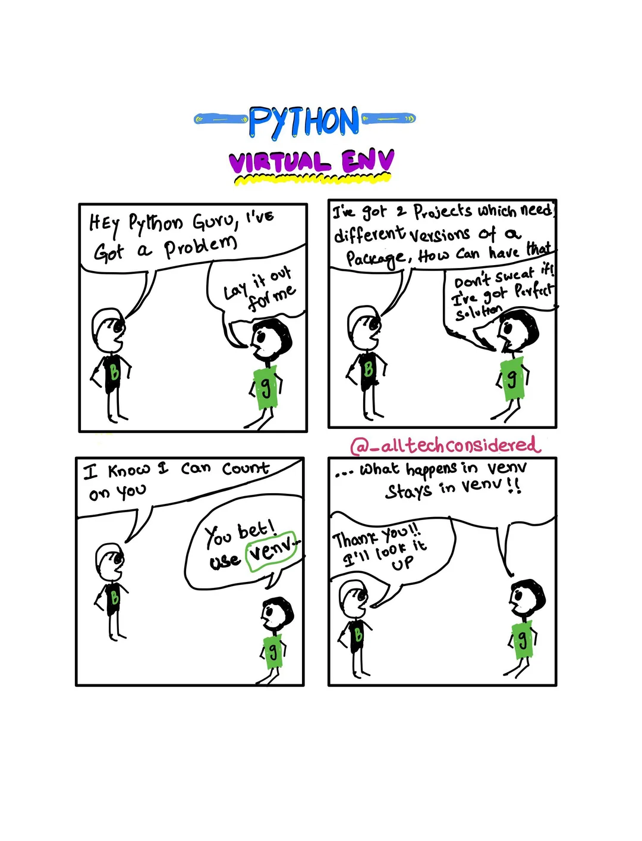
Virtual Environments

Slide 30
Why virtual environments?
Dependency conflicts
  Different versions of same package for different projects

Slide 31
Relevance to GitHub
pip freeze – list dependencies in virtual environment
pip freeze > requirements.txt
  Write dependencies in virtual environment to file
  Allows anyone to easily replicate GitHub project

Slide 32
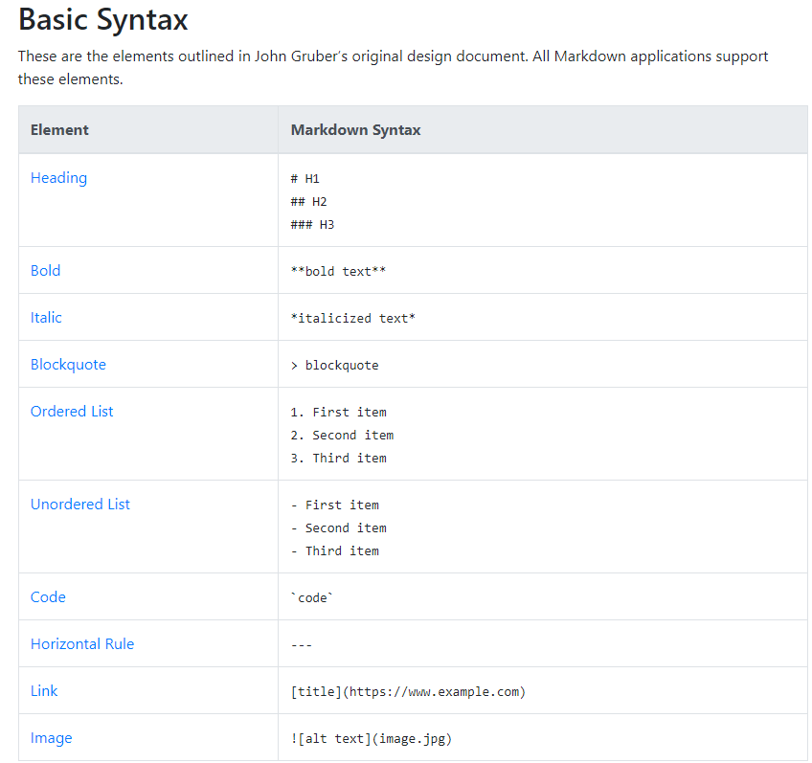
Markdown
Code important but readme file tells users how to use code
Markdown used to format file
https://www.markdownguide.org/cheat-sheet/

Slide 33
Resources for Learning GitHub
https://teamtreehouse.com/library/introduction-to-git
https://www.codecademy.com/learn/learn-git?utm_source=pepperjam&utm_medium=affiliate&utm_term=21181&clickId=4868498184&pj_creativeid=8-12462&pj_publisherid=21181
https://docs.github.com/en/get-started/start-your-journey/hello-world
http://www-cs-students.stanford.edu/~blynn/gitmagic/

